Slide 1
Not Sure how you Should React
SharePoint Fest Seattle
August 11, 2017
Presented By
Ryan Schouten
Code and Slides
http://bit.ly/SPFestReactDemo

Slide 2




About Me
Ryan Schouten
Utah SharePoint User Group President
Worked with SharePoint for > 10 years
I have experience with SharePoint 2003 – 2016
I have worked with ASP.Net for 15 years
http://www.sharepointknight.com

Slide 3

Office365 Implementations
Custom SharePoint Development
Responsive Design
Intranet Design/Implementations
3

Slide 4





Tooling
Build Process & Tooling
Code Editors
Gulp-based Build Process NodeJS/NPM SystemJS Webpack TypeScript
Visual Studio Code Atom Sublime
and more … your choice!

Slide 5
React Key Components
Build Components
Re-Render, Don’t Mutate
Fast Virtual
DOM
5

Slide 6
REACT Components
Small, reusable widgets of your application
UI layout and the UI logic are tightly coupled
Can be individual or have a parent/child relationship
Use state for storing data within the component
Use props to pass data and events to a child component
6

Slide 7
React Basics
Need to reference the React libraries
React
React-dom
Your markup is returned from the render method
7

Slide 8
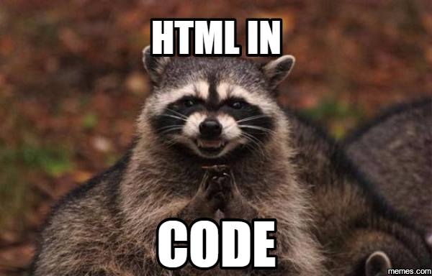

Markup in React
Added as part of your jsx or tsx
Per XHTML standard, React assumes lowercase tags are default html
Your components are added as mixed case tags
8

Slide 9
Demo

Slide 10
Props and State
Props
Using props to pass data to your components
Props are read-only
State
State allows us to receive/work with changeable data
Set initial state in constructor
Do not update directly use setState
Updates are merged
10

Slide 11
Lifecycle
constructor()
Used to set initial state
Best Practice don’t load external data here
componentDidMount()
Used to setup component and load external data
compononentWillUnmount()
Used for clean up
11

Slide 12
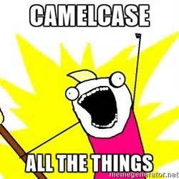
DOM Events
Events we add to our markup are not the standard HTML events
Events are camelCased not lowercased like HTML onclick vs onClick
You pass in the function to the event handler not a string
12

Slide 13
Conditional Rendering
Several methods
Store element as variable
Null elements will not be loaded
Inline if
Must use following syntax
Condition && <element>
Terniary operator
(condition)?<element1 />:<element2 />
13

Slide 14
Lists of Items
Use the JavaScript map command
Object.map((item) => { return <element /> })
Make sure you add a key attribute to help React with rendering and handling changes
Object.map((item) => { return <element key={item.ID} /> })
Keys must be unique among siblings
14

Slide 15
Forms and Output
Use onChange event to get the changed values
Output content using {}
15

Slide 16
React and SharePoint
Load external resources in your HTML file
Load HTML file in content editor
Use the SP-PNP-JS library for working with SharePoint data
16

Slide 17
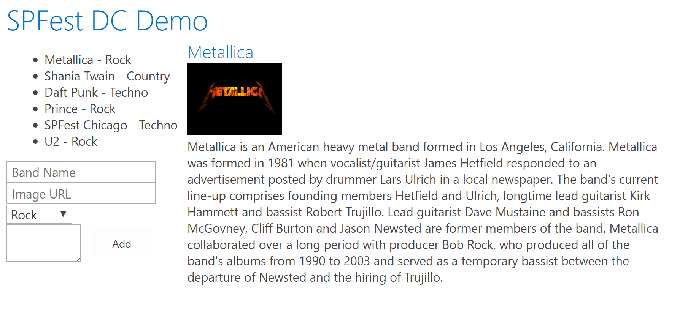
Thinking in React
Break things into reusable components

Slide 18
Demo
18

Slide 19



Office UI Fabric
Fonts, icons
Colors
Front end experiences for SharePoint
Powers OOB experiences
Available out of the box
Design web part seamlessly
Office UI Fabric React for rich set of reusable controls
Components
19

Slide 20
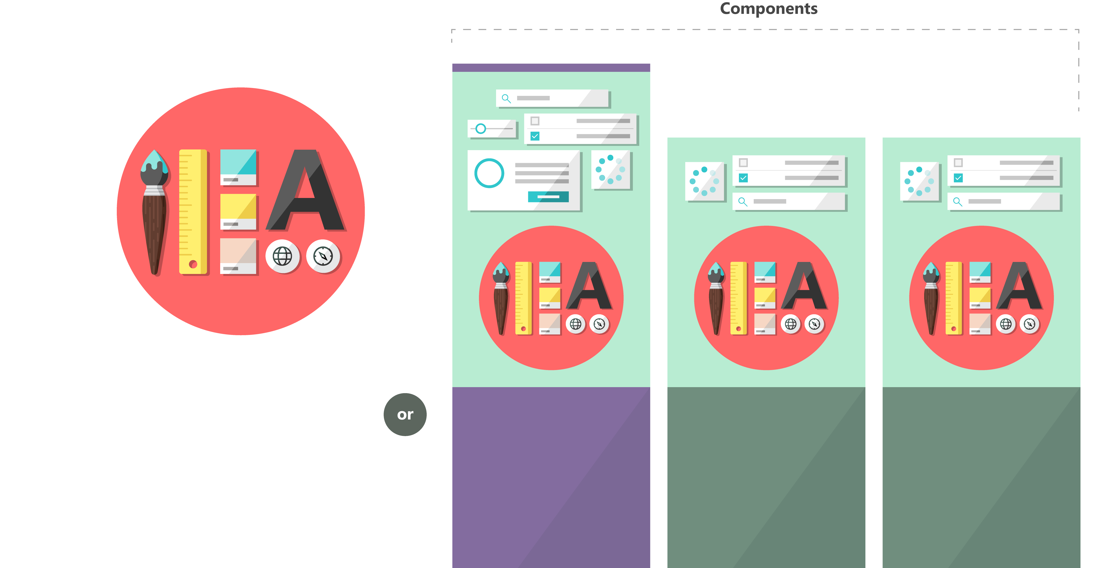

Fabric and its sub-projects
Fabric Core
Fabric React
Fabric JS
ngFabric
Fabric iOS
Core elements of the design language including icons, colors, type, and the grid
Robust, up-to-date components built with the React framework.
Simple, visuals-focused components that you can extend, rework, and build on.
Community-driven project to build components for Angular-based apps.
Native Swift colors, type ramp, and components for building iOS apps.
20

Slide 21
Demo
21

Slide 22

Questions
22

Slide 23


Slide 24
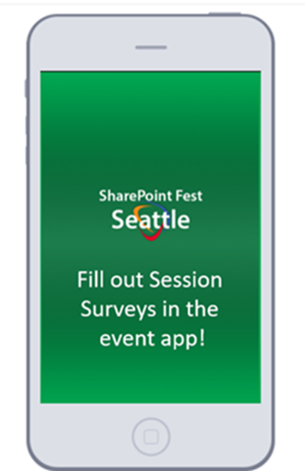

Slide 25
Thank You
www.sharepointknight.com
@shrpntknight
ryan@sharepointknight.com

